Slide 1




Indefinite High Altitude Flight for Earth and Mars Science
Principal Investigator: Dr. Sergey Shkarayev
Project Engineers: Adrien Bouskela, Reed Spurling, Maddie Schiffler, Scott Petersen
Presentation: Scott Petersen
2022 Arizona NASA Space Grant Statewide Symposium

Slide 2
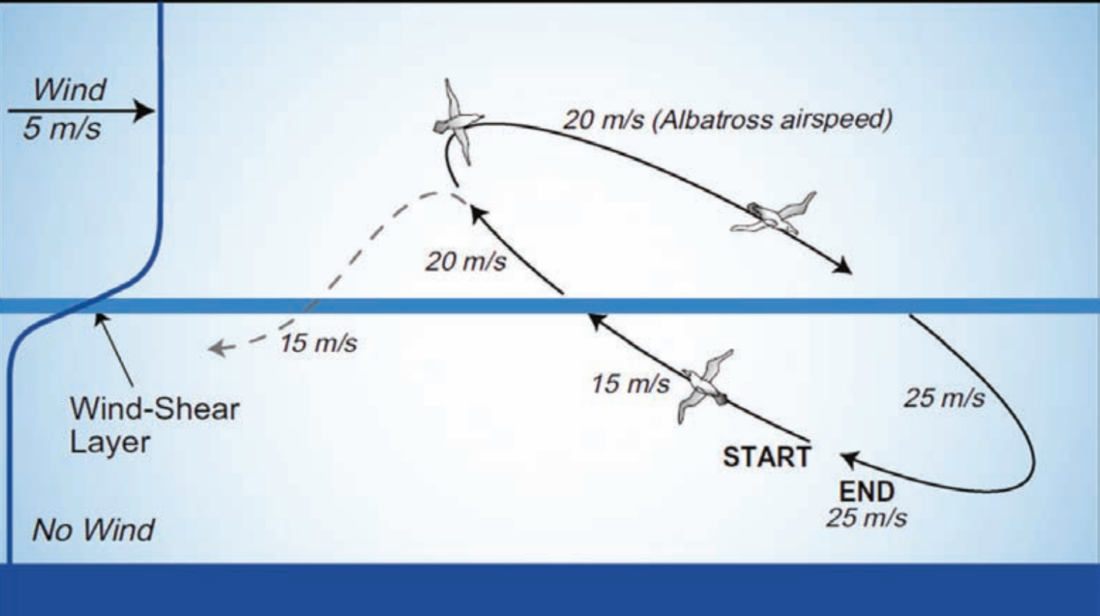

Dynamic Soaring
Harvest energy from a wind gradient
Notably used by albatrosses
Used to set R/C global speed record of 548mph (Simmie [2])
Figure from Bonnin et al. [1]

Slide 3
Motivation and Applications
Applications for Earth and Mars science
Continuous observation of one area
Closer to surface than satellites

Slide 4
Motivation and Applications
Earth
Mars
Direct atmospheric measurements
Large distance coverage
Closer than orbiters
High temporal resolution
Monitor climate change
Respond to natural disasters
Aid climate modelling
Monitor trace gases and greenhouse gases

Slide 5
Test Campaign Goals
Chief goal: demonstrate the ability to perform dynamic soaring in the stratospheric jet streams (lose as little mechanical energy as possible)
Conduct dynamic soaring autonomously
Transmit telemetry while in flight

Slide 6
Concept of Operations
Glider launches attached to a weather balloon
Once in the jet stream, the glider detaches
Experiment with dynamic soaring maneuvers
Deploy parachute and land
Throughout, maintain two-way communications with the glider

Slide 7
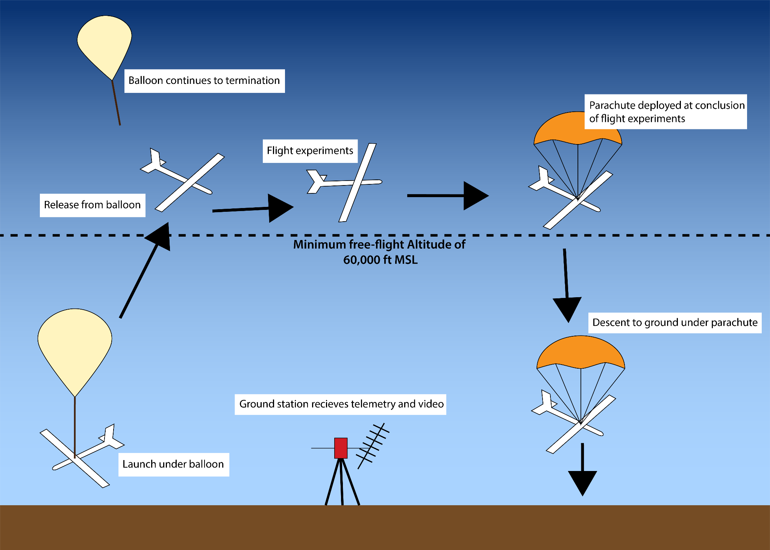

Slide 8
Activities this Year
Completed construction of the ground station
Upgraded to a new airframe
Conducted several low-altitude tests (no balloon attached)
Tested glider avionics on a high-altitude weather balloon
Important to note that the glider was not included on this mission

Slide 9
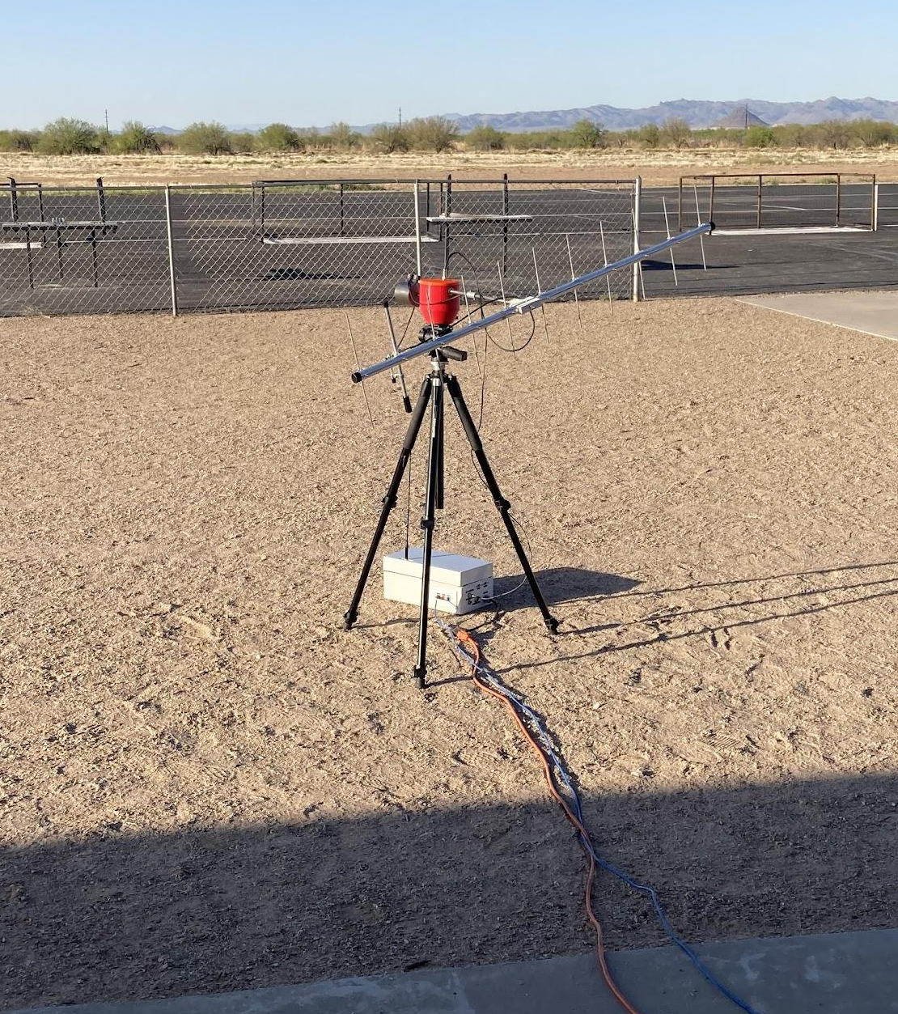
Progress: Ground Station
Spearheaded by Reed Spurling
Conducted long-range (>10km) tests
Successfully deployed on several low-altitude tests

Slide 10
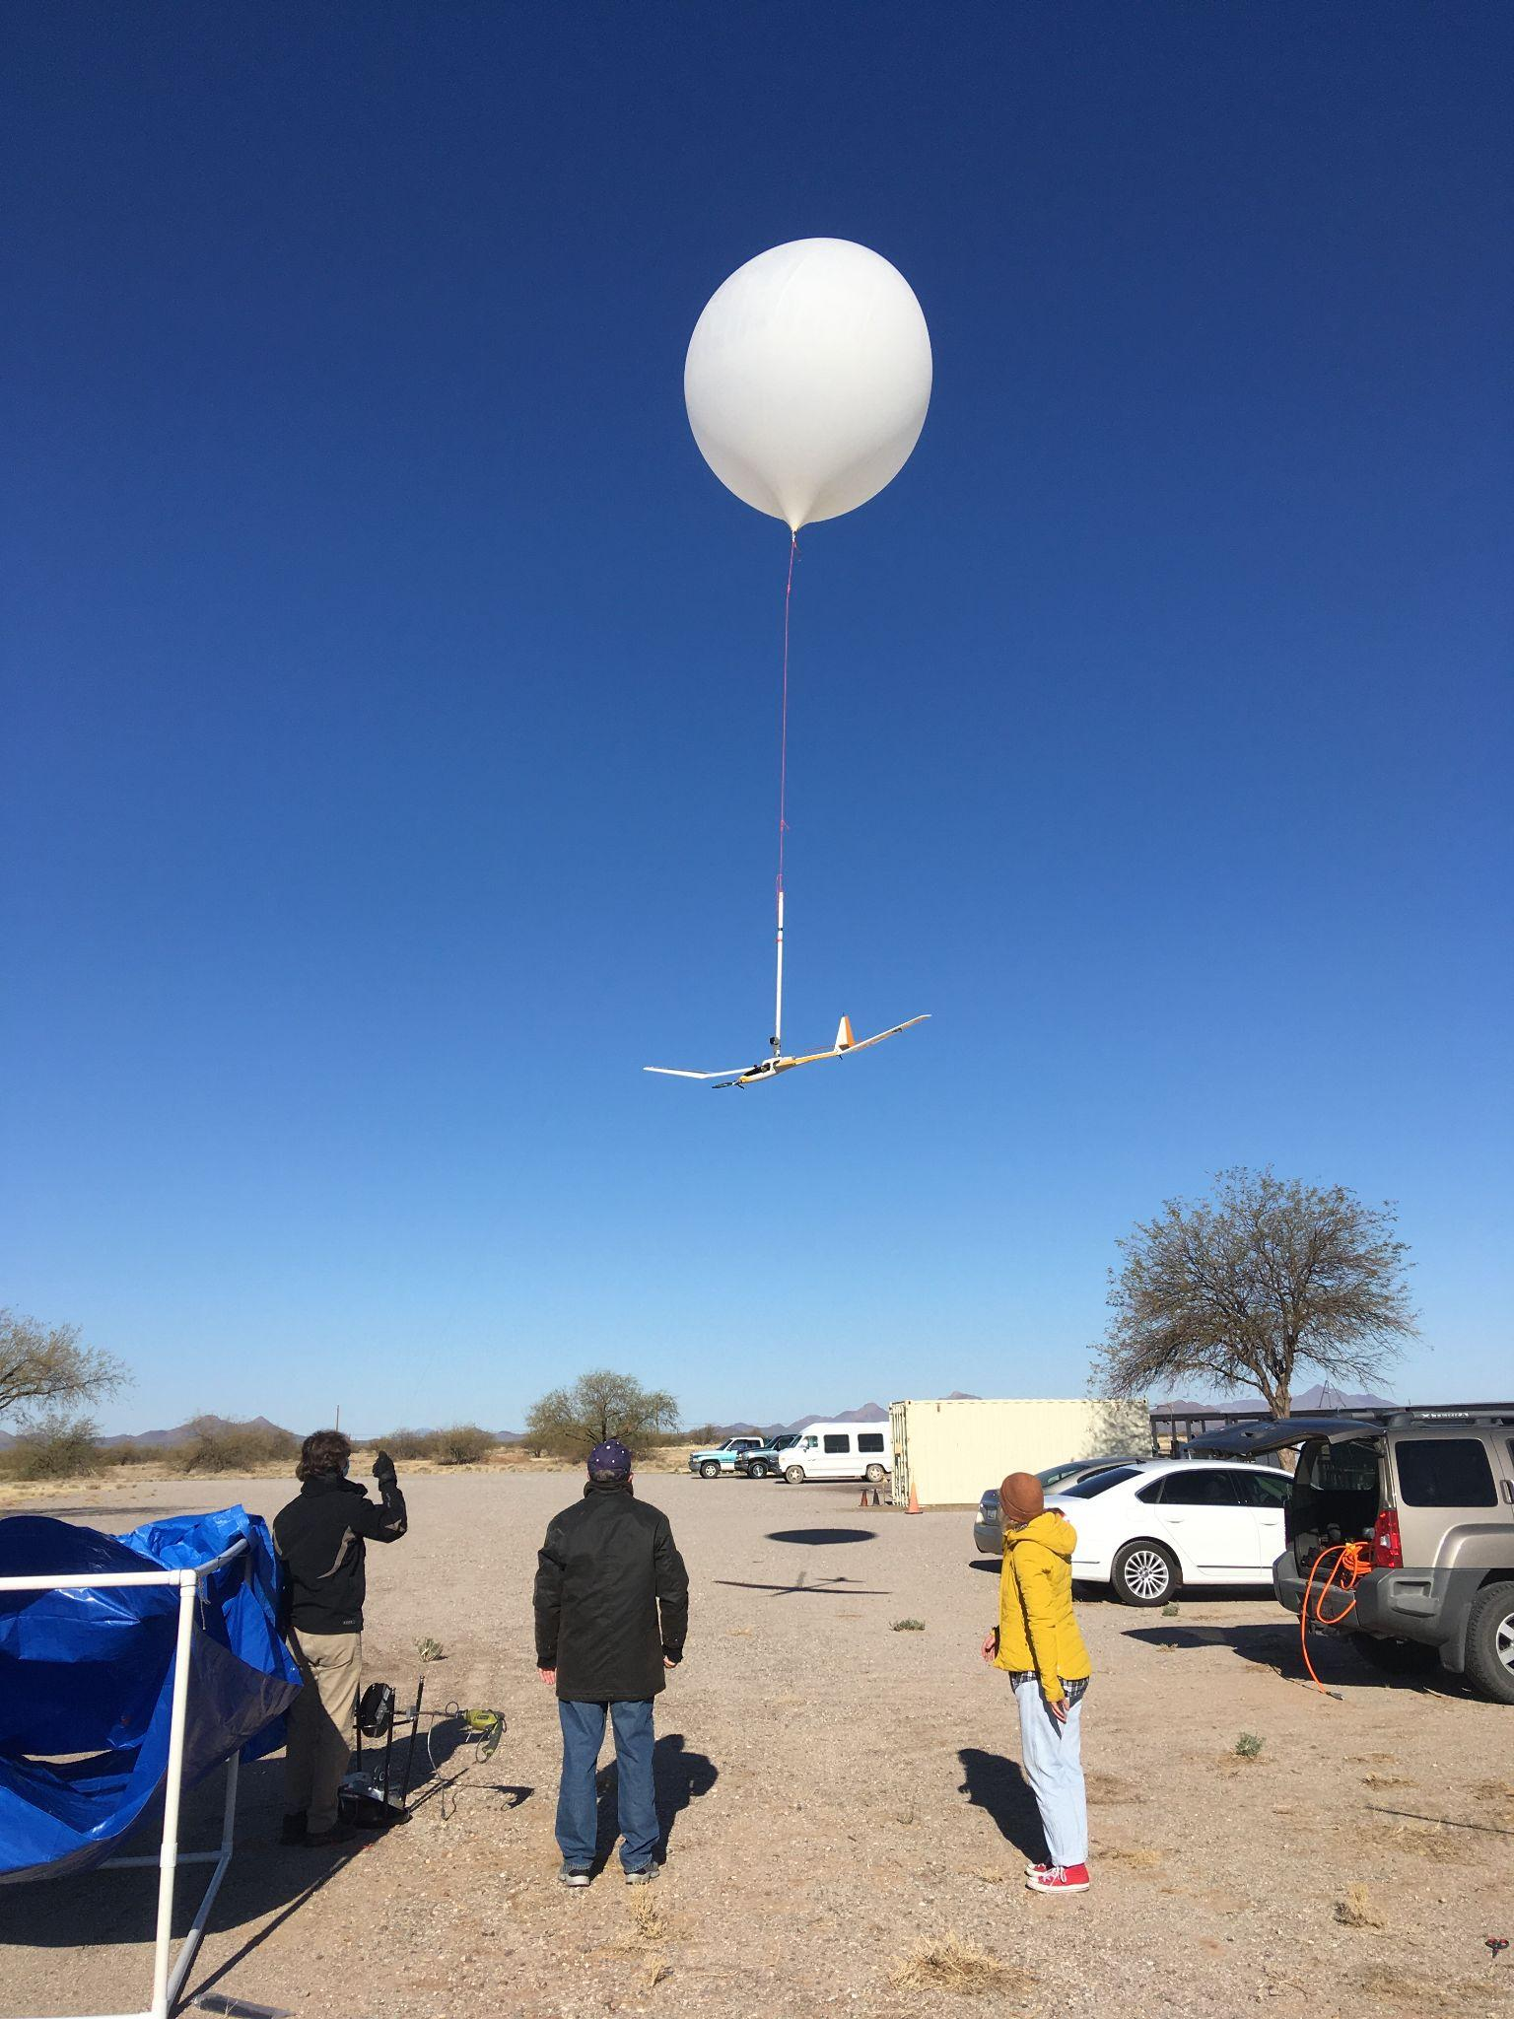
Progress: Glider
Autopilot has been programmed with dynamic soaring routines
Successfully flew autonomously on several low-altitude tests
Crashed, but upgraded to a better airframe
Damaged antenna, mitigations have been emplaced

Slide 11
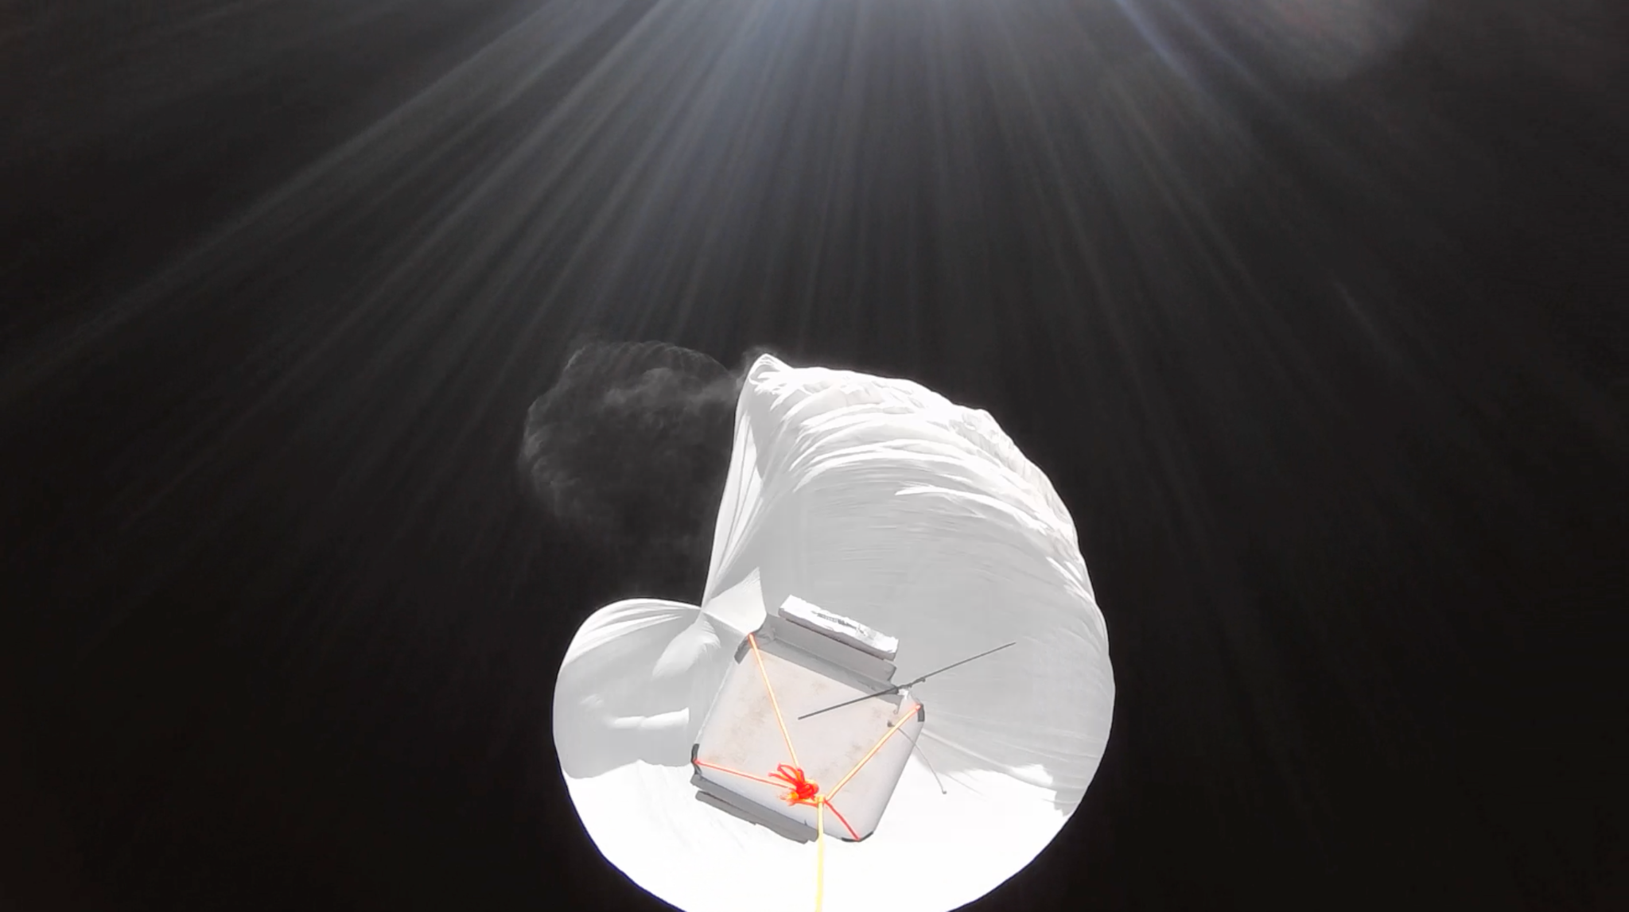
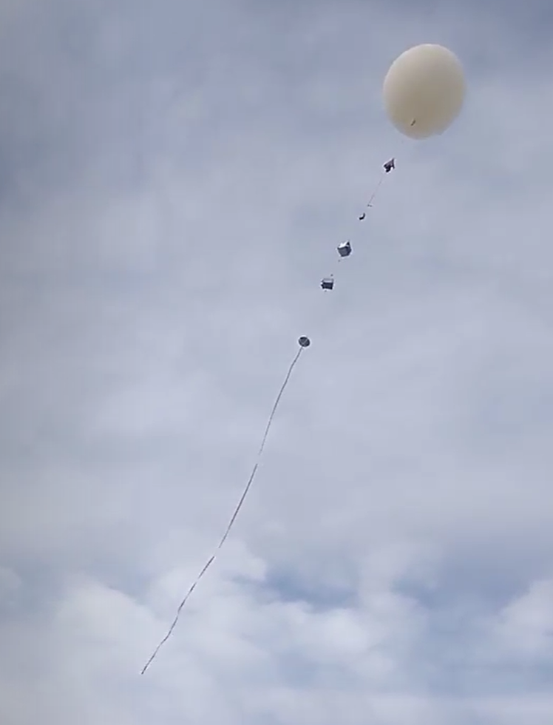
Progress: Glider, continued
Development of a new detachment system
Successfully tested glider avionics on a Near Space Club weather balloon flight
Images courtesy of Near Space Club

Slide 12
Conclusion and Next Steps
Despite a crash, we made very good progress this year
Include a parachute on the glider
Will be a pod inside the airframe
Largest remaining obstacle is regulatory approval
We will continue to work with the FAA

Slide 13
Acknowledgements
Dr. Sergey Shkarayev
Adrien Bouskela
Reed Spurling
Maddie Schiffler
Near Space Club
NASA
Arizona Space Grant Consortium
University of Arizona’s Department of Aerospace and Mechanical Engineering
Earth Dynamics Observatory

Slide 14
References
[1] Bonnin, V.; Benard, E.; Moschetta, J. M.; Toomer, C. A.; “Energy-Harvesting Mechanisms for UAV Flight by Dynamic Soaring,” International Journal of Micro Air Vehicles, Vol. 7, Issue 3, 2015, pp. 213-229
[2] Simmie, S. “Remote control glider sets speed record: 548 mph,” DroneDJ, 20 Jan. 2021, [Online]. Available: https://dronedj.com/2021/01/20/remote-control-glider-sets-world-speed-record-548-mph/.
[3] Koessler, J.H. “Dynamic Soaring Kinetic Energy Reference Frames,” Journal of Aircraft, Vol. 56, No. 1, 2019, pp. 22-29

Slide 15
Thank you!

